Slide 1
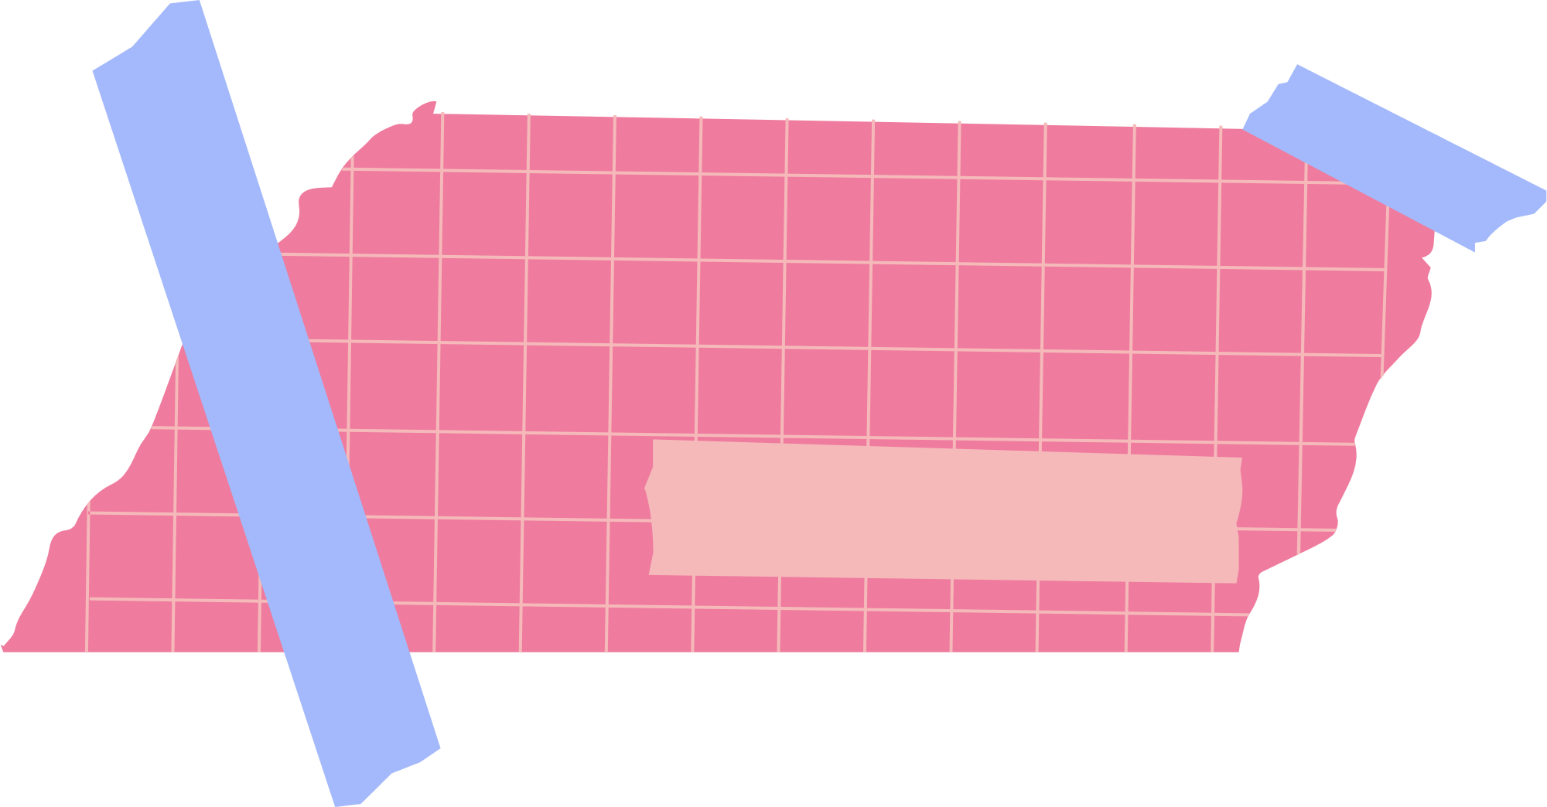





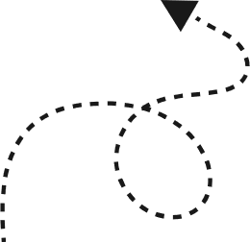
Reflection
UNDERSTANDING BIAS IN ALGORITHMS AND LEGAL SOLUTIONS
1
WHAT DID WE LEARNED?
2
what did we asked ourselves from our background?
LAW STUDENTS:
How a system is deployed
What does it look like in the system when we ask for compliance?
The existence of technical tools (SHAFT and FAIRLINK)
CS STUDENTS:
The importance of complying with the regulations, specifically the GDPR
My system can not only be technical, but it also needs an ethical approach
Assessments of risk in the development of the system
Principles of data protection - ART 5 GDPR! (lawfulness, fairnes and transparency)
As law students our first instinct was to approach the “bias in agorithim and solutions” task with a plan on how was data being treated and proetcted and if the result of the system adhere to nondiscriminatory policies
CS students went directly to two questions. How are we building the system, and what are we doing to prevent bias? It was focused in is my system working?
3
OUR SOLUTION
WE DEVELOPED A FLOWCHART TO DEPICT THE DIFFERENT PROCESSES REQUIRED TO BUILD AN AI MODEL AND AT EACH STAGE OF THE MODEL´S DEVELOPMENT WE IMPLEMENTED DIFFERENT TECHNICAL AND LEGAL SOLUTIONS TO MITIGATE BIAS AND ENSURE TRANSPARENCY.

Slide 2


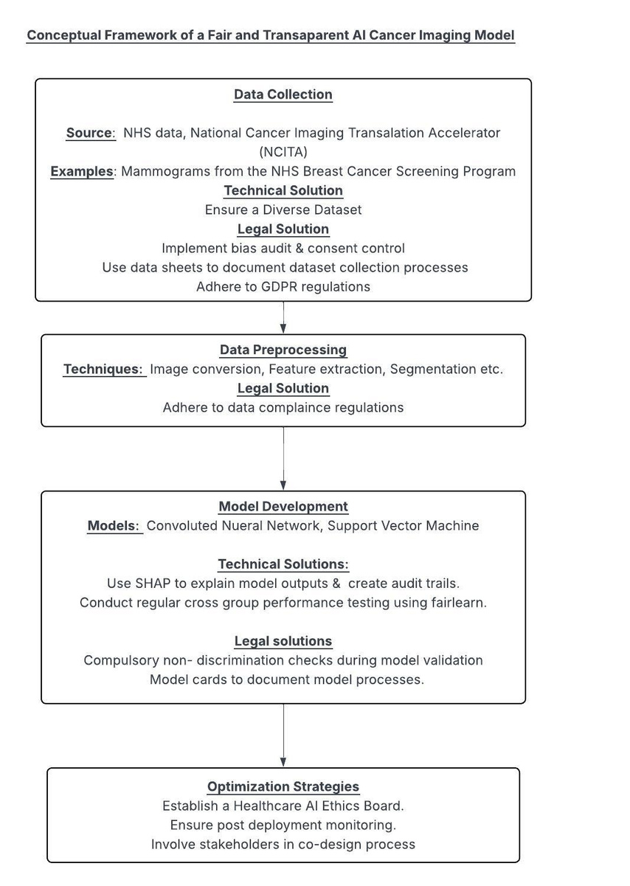
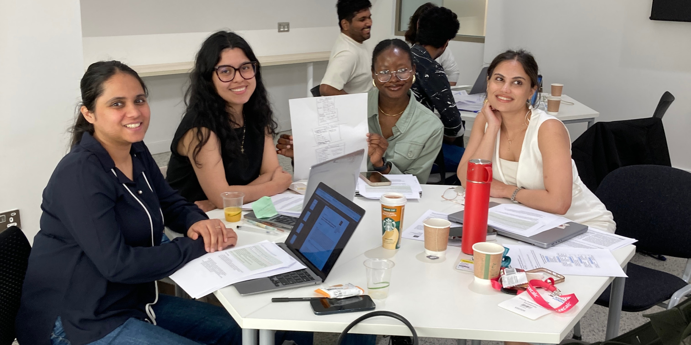
MOST PRODUCTIVE MOMENT OF OUR COLLABORATION
BUILDING THE LAW-TECH ARCHITECTURE!
It was a discovery moment for all of us to realise how much we could intervene in each others work and enhance it at every stage
WHAT DID WE LEARN?
WHAT DID WE LEARN?
CS STUDENTS: how important it is to think about the legality and compliance when building tech architectures. Once again, the importance of complying with the whole process to the GDPR, we learned a lot about ARTICLE 5!
LAW STUDENTS: learned profoundly about the process of building a system. We learned about feature extraction and all the positive aspects for data protection that go into the stage of data pre-processing. Ex. cleaning.

Slide 3



REFLECTIONS ON THE PROJECTS
LEGALITY CONFLICT WITH ALGORITHM THINKING AND THE INFLUENCE IN RESPONSIBILITY AND TRACEABILITY
TECHNICAL ASSUMPTIONS
HOW DID WE COMMUNICATE?
We revised technical assumptions by identifying when model features (like age or gender) risked violating equality laws, prompting us to adjust model design for fairness and legal compliance. Eg under Equality Act we could not include gender because it can lead to performing worse for a particular gender,
Accountability was a challenge because AI systems are often a black box. Legal frameworks often stuggle to map responsiblity because harm is caused by an automated process.We solved it by designing AI systmes with explainability tools like Shap and audit trails so decisions can be traced, reviewed and challenged.
We thpught some obstacles might t¡be hoiw to comply with privacy and data proetction, when it is impssible to use some pricnciples like data minimisation because it will affectd the system operations
For responsability and traceability we found thta solkutions such as contracts, consent agreements and consent finormation have a great IMPACT in owning reposnsability over the data subjects data and being transparent about the operations
EXAMPLES, EXAMPLES, EXAMPLES!
We found easier to communicate through examples to erase the echnicalities of our languages - we had a lot of technical jargon thta had to be simplfied and exampoles were the best solution
TO explain how a risk assemsent works and when the deployer might be obligated to compky, we explained with an example on how a RISK assessment looks like and how it should be answered and accodirng to it, the obligations in each setage of the process - to explain principles of the GDPR. we also uses examples. For transparency “We may use your personal data to personalise your experience” to explain the DS why their data is being used
RECOMMENDATIONS
CREATION OF AN ETHICS AND LEGAL COMPLIANCE MODULE FOR COMPUTER SCIENCE STUDENTS, PARTICULARLY IN OUR MSC PROGRAMME, SO WE ARE TAUGHT ABOUT HOW BIAS CAN ENTER THE MODELS WE BUILD AND EXPLAIN THE OUTPUT OF OUR MODELS AND HOW IT COMES TO THE DECISIONS IT MAKES.
AS Data Science students, we explained how the Shapley model works in simple terms. Shapley values calculate how much each factor contributes by looking at every possible combination and measuring the final impact. The example used was the pizza party: 3 friends decide to make pizza. One brought the cheese, one friend brought tomato sauce, and one brought toppings. At the end, who deserves how much credit for making pizza so good?

Slide 5


